Slide 1
PROJECT TITLE

Slide 2
EMPLOYEE DATE ANALYSIS USING EXCEL
STUDENT NAME: agalya.p
REGISTER NO : 312216361
DEPARTMENT : III BCOM(COMPUTER APPLICATION)
COLLEGE :SHRI SHANKARLAL SUNDARBAI SHASUN Jain COLLEGE FOR WOMEN

Slide 3
AGENDA
1.PROBLEM STATEMENT 2.PROJECT OVERVIEW 3.END USERS 4.OUR SOLUTION ANDPROPOSITION 5.DATASET DESCRIPTION 6.MODELLING APPROACH 7.RESULTS AND DISCUSSION 8.CONCLUSION

Slide 4
PROBLEM STATEMENT
"Existing employee performance analysis processes are inaccurate, inefficient, and ineffective, hindering employee growth and organizational success. A modern, data-driven, and integrated solution is needed to bridge the gap between individual performance and business objectives.

Slide 5
PROJECT OVERVIEW
The Employee Performance Analysis project aims to design and implement a comprehensive, data-driven, and integrated performance management system, enabling accurate assessments, informed decision-making, and enhanced employee growth.

Slide 6
WHO ARE THE USERS
- Human Resources (HR) professionals, who use performance data to identify training needs, inform recruitment decisions, and ensure compliance with labor laws and regulations. Managers and supervisors, who use performance analysis to set goals, provide feedback, and make informed decisions about promotions, bonuses, and disciplinary actions. Employees themselves, who use performance feedback to understand their strengths and weaknesses, set personal goals, and develop their skills and careers.Organizational leaders, who use aggregated performance data to identify trends, optimize resource allocation, and drive strategic decision-making.Compensation and benefits analysts, who use performance data to design and administer fair and competitive compensation and benefits programs.These users may have different needs and perspectives, but they all rely on accurate and actionable employee performance analysis to achieve their goals.

Slide 7
THE WOW IN OUR SOLUTION
Our employee performance analysis solution offers a WOW factor through its cutting-edge features, including:
AI-driven insights that uncover hidden patterns and trends in performance data, enabling predictive analytics and data-driven decision-making.Real-time feedback and coaching tools that foster continuous growth and improvement, boosting employee engagement and retention.Personalized development plans tailored to each employee's strengths, weaknesses, and career aspirations, ensuring targeted skill-building and progression.Seamless integration with existing HR systems and processes, streamlining data management and reducing administrative burdens.Intuitive dashboards and visualizations that provide clear, actionable views of performance metrics, empowering managers and employees to make informed decisions.- Advanced analytics and benchmarking capabilities that facilitate fair and equitable performance evaluations, reducing bias and promoting merit-based recognition.These innovative features combine to create a WOW experience that sets our solution apart, transforming employee performance analysis into a dynamic, impactful, and employee-centric process.

Slide 8
OUR SOLUTION AND ITS VALUE PROPOSITION
FILTERING
MISSING VALUES
CONDITION FORMATING -BLANK VALUES
PIVOT
TABLE CHART

Slide 9
DATASET DESCRIPTION
EMPLOYEE DATE SET –KAGGLE
26 FEATURES
FEATURES-9 FEATURES
EMP ID
GENDER -MALE, FEMALE
PERFORMANCE
BUSINESS UNIT
NAME
RATING -NUMERICAL

Slide 10
MODELLING
MODELLING
DATA COLLECTION
DATA CLEANING
TECHNIQUES
RESULTS
PIVOT TABLE
CHART GRAPHS

Slide 11
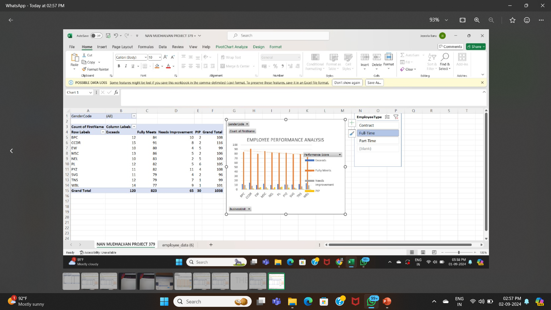
RESULT

Slide 12
CONCLUSION
In conclusion, employee performance analysis is a vital process that enables organizations to measure, manage, and enhance individual and team performance. By leveraging advanced analytics, AI-driven insights, and continuous feedback, employers can Unlock employee potential and drive growth Inform data-driven decisions on promotions, bonuses, and development opportunities Foster a culture of transparency, accountability, and merit-based recognition Improve employee engagement, retention, and overall well-being Achieve strategic objectives and drive business successBy implementing a comprehensive and user-centric employee performance analysis solution, organizations can transform their workforce into a high-performing, adaptable, and resilient engine for growth and innovation.

